Slide 1
WCRF International webinar
17th July 2019

Slide 2
The content of these slides has been recorded as a webinar with audio commentary from WCRF International staff.
Please follow the link below to access the free recording:
wcrf.org/int/latest/news-updates/diet-and-cancer-webinar

Slide 3
The global impact of diet, nutrition and physical activity on cancer

Slide 4
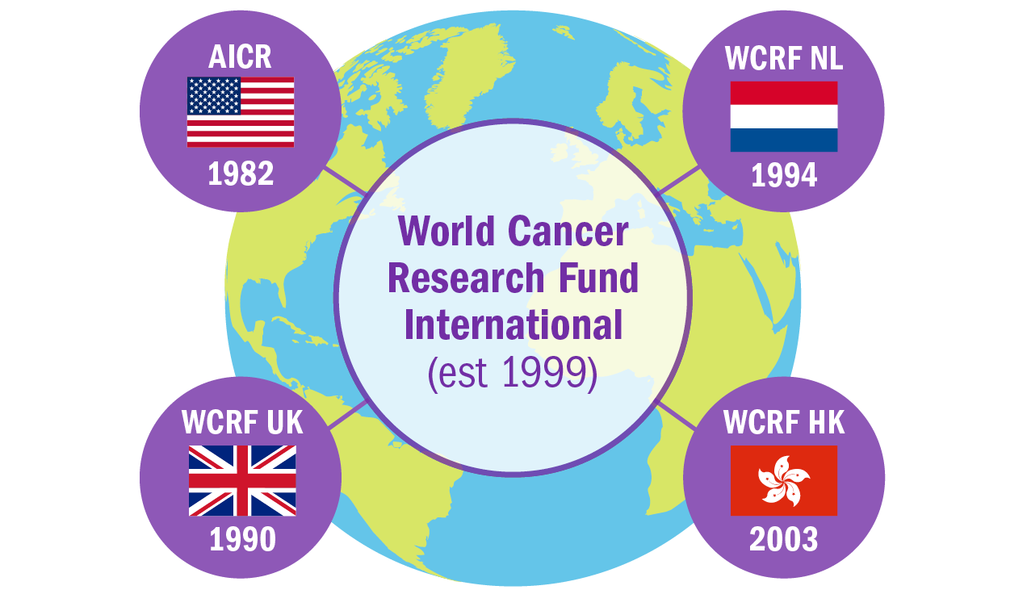
The World Cancer Research Fund Network
American Institute for Cancer Research
Wereld Kanker Onderzoek Fonds
World Cancer Research Fund International leads and unifies a network of cancer charities with a global reach, dedicated to the prevention of cancer through diet, nutrition and physical activity
World Cancer Research Fund UK
World Cancer Research Fund Hong Kong*
*Since 2016, WCRF HK has operated though Ambassadors at the University of Hong Kong
wcrf.org/about-the-report

Slide 5
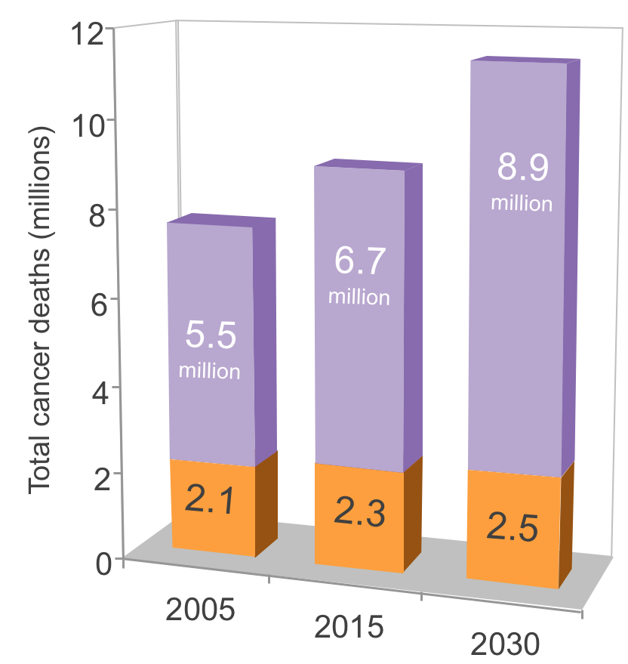
Deaths from cancer
In all low- and middle income countries, cancers now account for a large enough share of premature deaths and poverty to merit an urgent and coordinated public policy response
Low- and middle income countries
High-income countries
Source: The global burden of disease: 2004 update (WHO, 2008)

Slide 6
Global variation in cancer incidence
Breast
Stomach
Cervix
Source: Globocan, WHO 2018

Slide 7
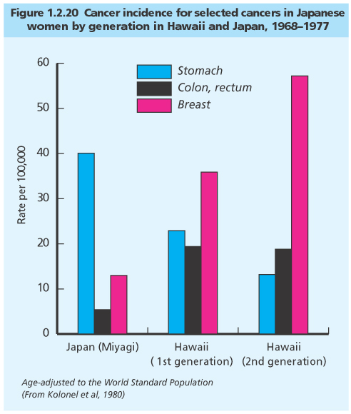
Migration data

Slide 8
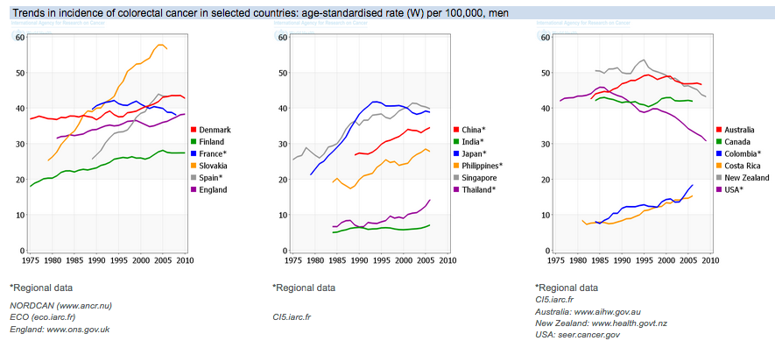
Colorectal cancer incidence trends
Selected countries, men, 1975 to 2010

Slide 9
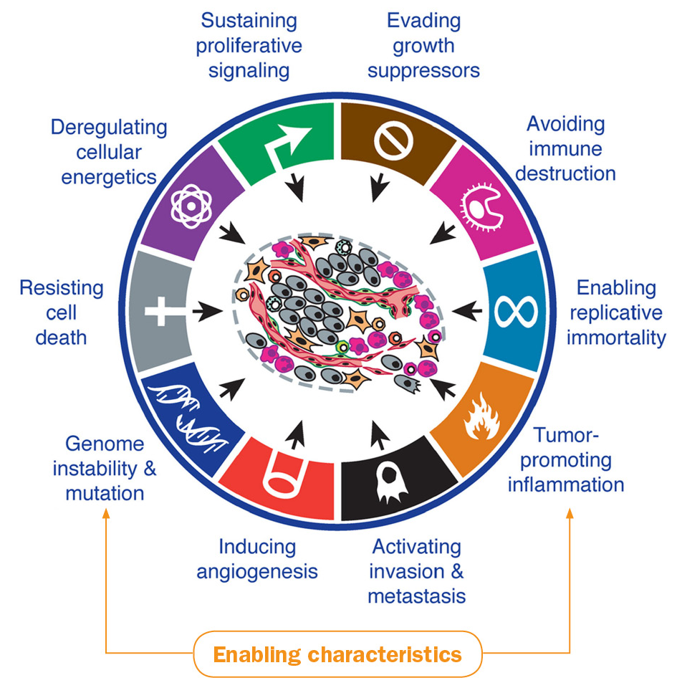
Hallmarks of cancer and enabling characteristics
Source: Hanahan & Weinberg (2011) Cell; Hanahan & Coussens (2012) Cancer Cell

Slide 10
Obesity, physical activity and the hallmarks of cancer
Altered mitochondrial function; increased nutrient uptake in obesity-associated tumours
Oestrogen, MAPK, ERK
Insulin, PI3K, mTOR
Adipose stromal cells influence peritumoural vascularisation and inflammation
Adipose tissue-associated inflammation, leptin, STAT
wcrf.org/dietandcancer/cancer-process

Slide 11
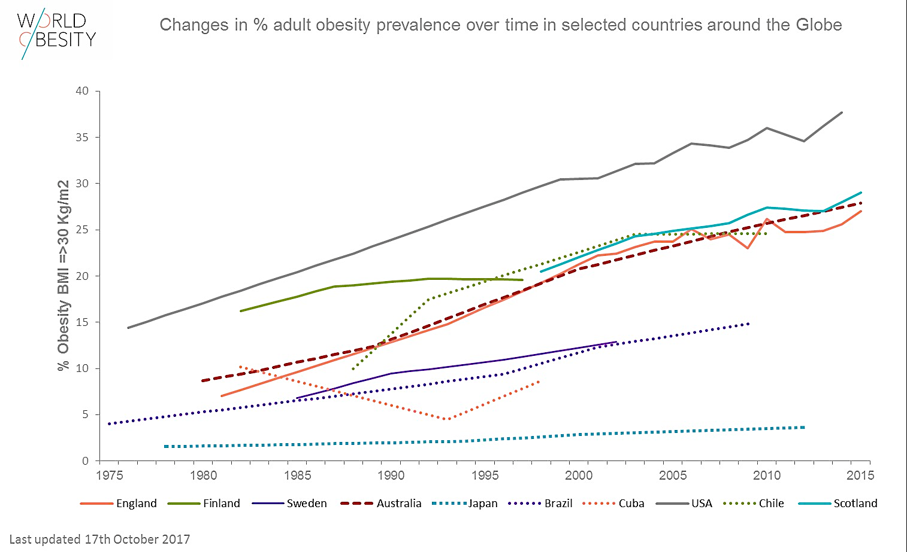
Changes in adult obesity prevalence

Slide 12
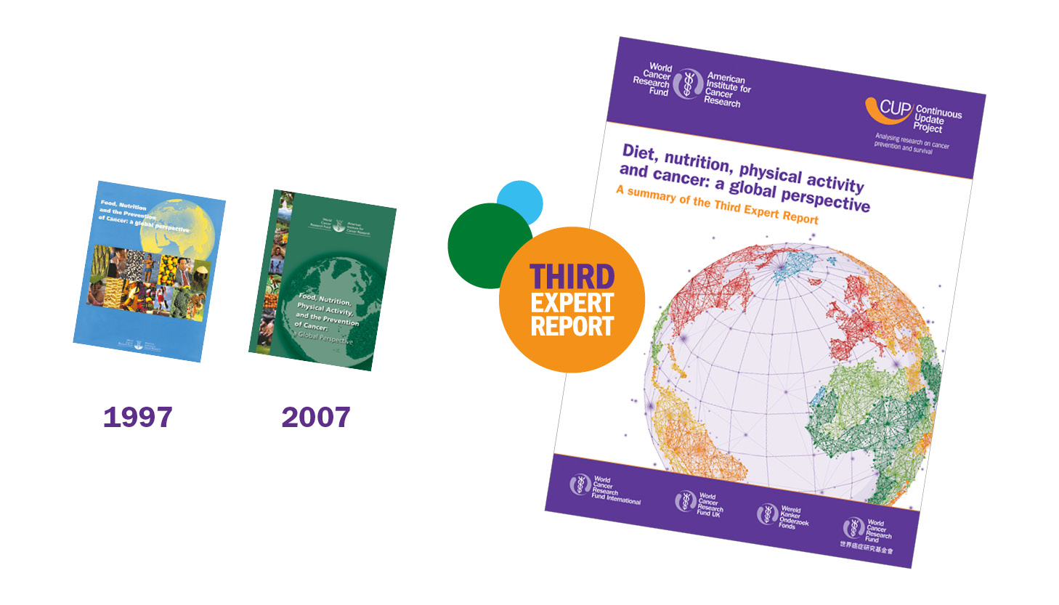
WCRF/AICR Continuous Update Project
Systematic reviews – rigorous protocol
Review of evidence separate from judgement
Independent international expert panel
Predetermined criteria for judgements - Epidemiology - Mechanisms
Continuous update of the evidence

Slide 13
The evidence is judged using grading criteria
 |  | Decreases risk | Increases risk
Strong evidence | Convincing
 | Probable
Limited evidence | Limited - suggestive
 | Limited – no conclusion
Strong evidence | Substantial effect on risk unlikely
Evidence Matrix
Pre-determined criteria for grading the evidence:
Number and types of studies
Quality of exposure and outcome assessment
Heterogeneity within and between study types
Exclusion of chance, bias or confounding
Biological gradient
Evidence of mechanisms
Size of effect
Basis for Recommendations
wcrf.org/dietandcancer/judging-evidence

Slide 14
2007 Cancer Prevention Recommendations

Slide 15
Adherence to the 2007 Recommendations
Cancer risk
Score constructed to measure adherence to WCRF/AICR Cancer Prevention Recommendations
Total mortality
P for trend <0.0001
Romaguera et al (2012), AJCN
P for trend <0.0001
Results shown for women
Cox regression model stratified by centre and age, and adjusted by level of school, smoking status, smoke intensity, and menopausal status
Vergnaud et al (2013), AJCN
wcrf.org/dietandcancer/recommendations/evidence-our-recommendations-work

Slide 17
The Cancer Prevention Recommendations

Slide 18
Recommendations are underpinned by guiding principles
Cancer Prevention Recommendations designed to be used as the basis for action and to inform policy to reduce the incidence of cancer in general.
Together, they represent an integrated pattern of behaviours that can be considered as an overall ‘package’.
Culturally relevant throughout the world.
Guidelines on the prevention of other diseases taken into account.
wcrf.org/dietandcancer/cancer-prevention-recommendations

Slide 19
The Recommendations form an overall package
wcrf.org/dietandcancer/cancer-prevention-recommendations

Slide 20
CUP evidence: Increased risk of 12 cancers
IARC*: Increased risk of thyroid cancer, multiple myeloma, meningioma
Overweight and obesity in childhood and early life tend to track into adulthood
Greater body fatness increases the risk of other diseases such as heart disease
*IARC, International Agency for Research on Cancer
wcrf.org/dietandcancer/recommendations/be-healthy-weight

Slide 21
Please note: This slide has animated features in presentation mode
Strong evidence for recommendations
CUP evidence: Reduced risk of bowel, breast and womb cancers
Indirect: Other cancers via effect on obesity
Moderately physically active
Follow or exceed national guidelines
Role of sedentary behaviours
Be physically active
Be physically active as part of every day life – walk more and sit less
Dietary fibre and wholegrains protective against bowel cancer
Dietary fibre decreases risk of weight gain and obesity
Non-starchy veg and fruit help protect against aerodigestive cancers*
30g fibre per day
“5-a-day” (400g) fruit and veg
Most meals
Eat a diet rich in wholegrains, vegetables, fruit and beans
Make wholegrains, vegetables, fruit and pulses (legumes) such as beans and lentils a major part of your usual diet
* ‘Aerodigestive cancers’ include: mouth and throat; nasopharynx; oesophagus; lung; stomach; and bowel.
wcrf.org/dietandcancer/recommendations/be-physically-active
wcrf.org/dietandcancer/recommendations/wholegrains-veg-fruit-beans
Notes:
Please note: This slide has animated features in presentation mode

Slide 22
Please note: This slide has animated features in presentation mode
Strong evidence for recommendations
CUP evidence: ‘Fast foods’ and a ‘Western type’* diet increase the risk of weight gain, overweight and obesity
CUP evidence: Glycaemic load increases the risk of womb cancer
Relevant for prevention of other diseases
Limit consumption of ‘fast foods’ and other processed foods high in fat, starches or sugars
Limiting these foods help control calorie intake and maintain a healthy weight
CUP evidence: Sugar sweetened drinks increase the risk of weight gain, overweight and obesity
Provide energy but may not influence appetite in the same way as food does so can promote overconsumption of calories leading to weight gain
Type 2 diabetes
Dental caries and poor oral health
Limit consumption of sugar sweetened drinks
Drink mostly water and unsweetened drinks
*A 'Western type’ diet is characterised by high intakes of free sugars, meat, and dietary fat
wcrf.org/dietandcancer/recommendations/limit-fast-foods-fat-sugar
wcrf.org/dietandcancer/recommendations/limit-sugar-sweetened-drinks
Notes:
Please note: This slide has animated features in presentation mode

Slide 23
Please note: This slide has animated features in presentation mode
Strong evidence for recommendations
CUP evidence: Increased risk of six cancers
But…decreased risk of kidney cancer
Heavy drinking associated with increased risk of liver disease, pancreatitis and CVD*
Effect of moderate drinking on non-cancer outcomes?
Limit alcohol consumption
For cancer prevention, it’s best not to drink alcohol
CUP evidence: Red meat and processed meat both increase the risk of bowel cancer
Three portions per week (350-500g cooked weight)
Balancing the advantages and disadvantages of eating red meat
Limit consumption of red and processed meat
Eat no more than moderate amounts of red meat, such as beef, pork and lamb. Eat little, if any, processed meat
CUP evidence: High-dose beta-carotene increases risk of lung cancer (current and former smokers)
For most people, it is possible to obtain adequate nutrition from a healthy diet that includes the right foods and drinks
Supplementation may be needed to achieve adequate nutrient intake for some people
Do not use supplements for cancer prevention
Aim to meet nutritional needs through diet alone
*Cardiovascular disease
wcrf.org/dietandcancer/recommendations/limit-alcohol-consumption
wcrf.org/dietandcancer/recommendations/limit-red-processed-meat
wcrf.org/dietandcancer/recommendations/dont-rely-supplements
Notes:
Please note: This slide has animated features in presentation mode

Slide 24
Please note: This slide has animated features in presentation mode
Strong evidence for recommendations
CUP evidence:
Mothers: Decreases risk of breast cancer Children: Having been breastfed decreases risk of obesity
Aligns with WHO recommendation for exclusive breastfeeding for six months
Other benefits of breastfeeding, including lower risk of infections for the infant
For mothers: breastfeed your baby, if you can
Breastfeeding is good for both mother and baby
Nutritional and physical activity factors can reliably predict outcomes for breast cancer
Quality…?
Likely to help prevent other diseases and help manage co-existing disease
After acute stage of treatment, with input from trained professionals
After a cancer diagnosis: follow our Recommendations, if you can
Check with your health professional what is right for you
wcrf.org/dietandcancer/recommendations/breastfeed-your-baby
wcrf.org/dietandcancer/recommendations/during-after-cancer
Notes:
Please note: This slide has animated features in presentation mode

Slide 25
Regional and special circumstances
Public health significance
Relevant to specific regions
Inadequate information
Divergent evidence between sites
Height and birthweight
Arsenic in drinking water
Aflatoxins
Mate
Foods preserved by salting
Cantonese-style salted fish
Coffee
‘Mediterranean type’ dietary pattern
Dairy products and calcium
wcrf.org/dietandcancer/recommendations/regional-variations

Slide 26
Resources
🌍 Third Expert Report Diet, nutrition, physical activity and cancer: A global perspective Open access: wcrf.org/dietandcancer
🗣 Recommendations available in other languages 🇳🇱 Dutch 🇨🇳 Mandarin 🇫🇷 French 🇩🇪 German 🇪🇸 Spanish
🛠 Toolkits and ready-made slide sets Free to use: wcrf.org/dietandcancer/resources-and-toolkit
💻 Online cancer health checks 🇬🇧 wcrf-uk.org/uk/cancer-health-check
🇳🇱 wkof.nl/nl/cancer-health-check
🇺🇸 cancerhealthcheck.org

Slide 28
Translating the science into policy

Slide 29
Outline
Why we need policy action – obesogenic environments; global targets
NOURISHING framework
New policy framework – how it was designed; how to use it; its intended impact
Conclusion – next steps

Slide 30
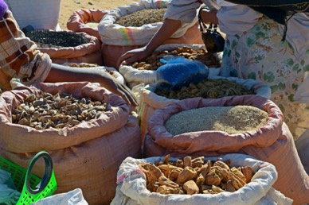
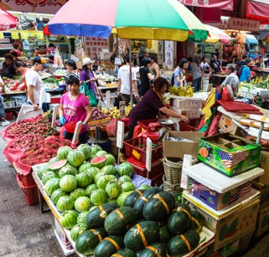
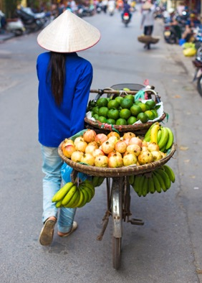
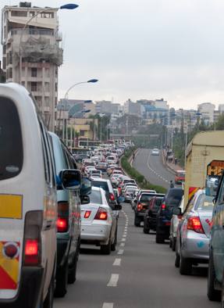
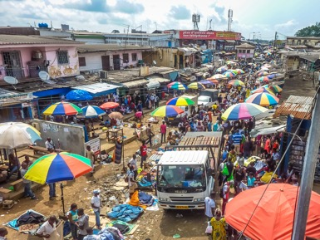

Slide 31
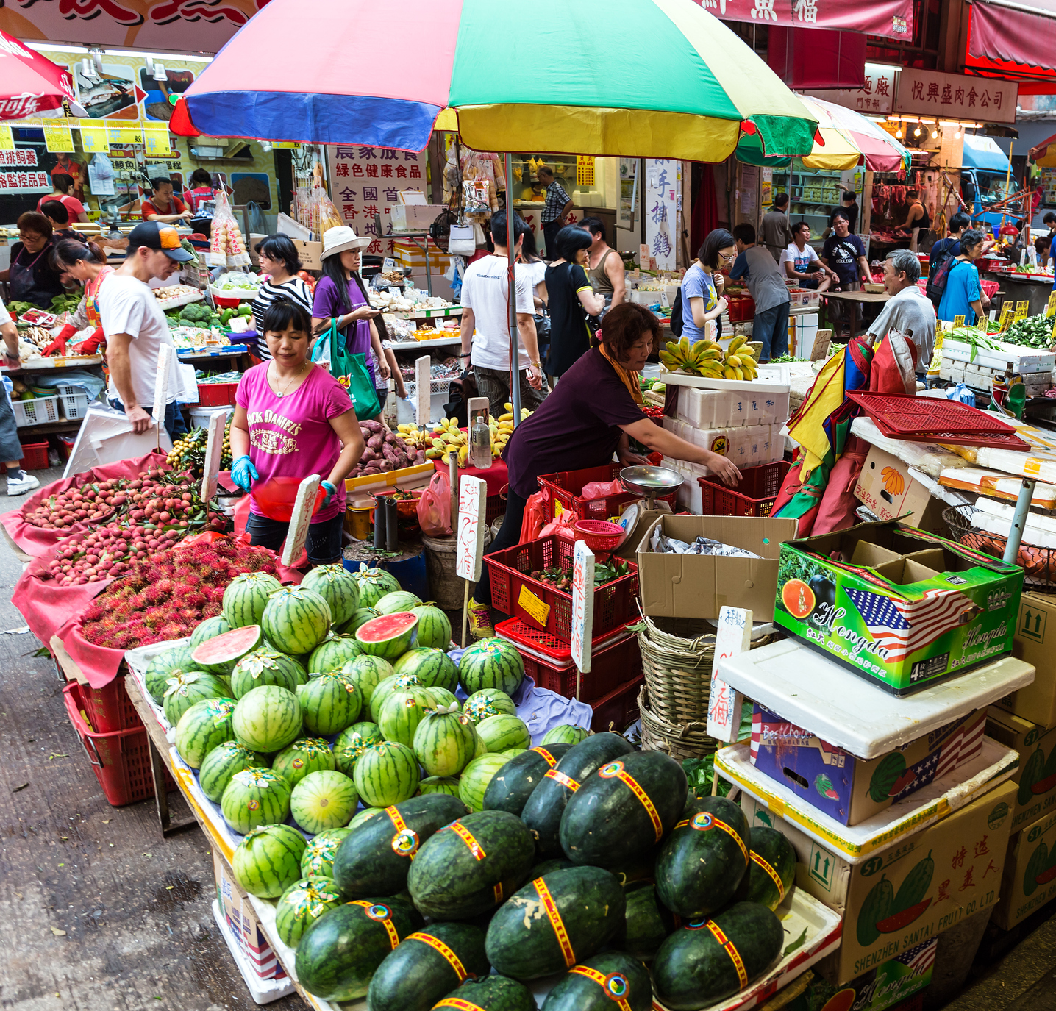
Importance of policy action
It is critical to consider the environment in which people make choices, as behaviour is influenced by environmental, economic and social factors
Understanding these ‘upstream’ determinants of cancer risk highlight opportunities for policy action
Public health policies that prioritise prevention, in the form of laws, regulations and guidelines, are critical to preventing cancer and other non-communicable diseases

Slide 32
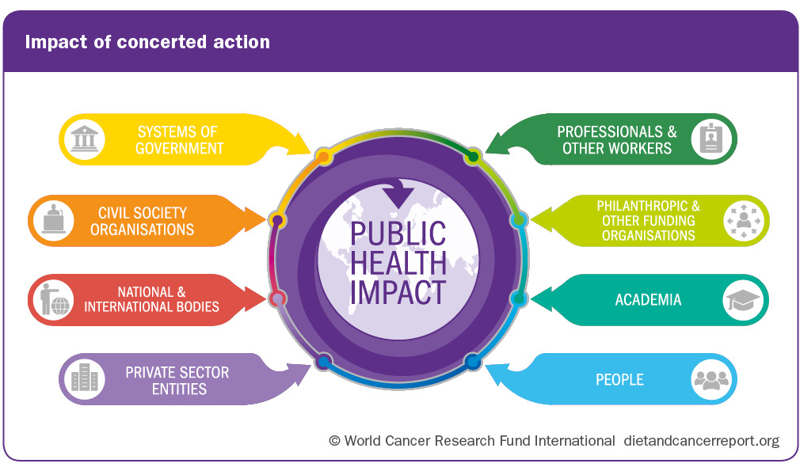
Action needed across all sectors of society

Slide 33
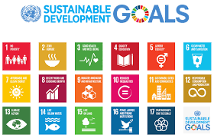
Global targets
Target 3.4: By 2030, reduce by one third premature mortality from non-communicable diseases
By 2025:
Halt the rise in diabetes and obesity
A 25% relative reduction in risk of premature mortality from four main non-communicable diseases

Slide 34
Using a policy framework to support action
Policy frameworks can help policymakers to:
conceptualise, organise and package policies to address risk factors
plan, develop, implement and evaluate policies
identify available policy levers and policy options that can be used to create health-enhancing environments
develop a comprehensive policy approach, which can be adapted to reflect national contexts to achieve system-wide change

Slide 35
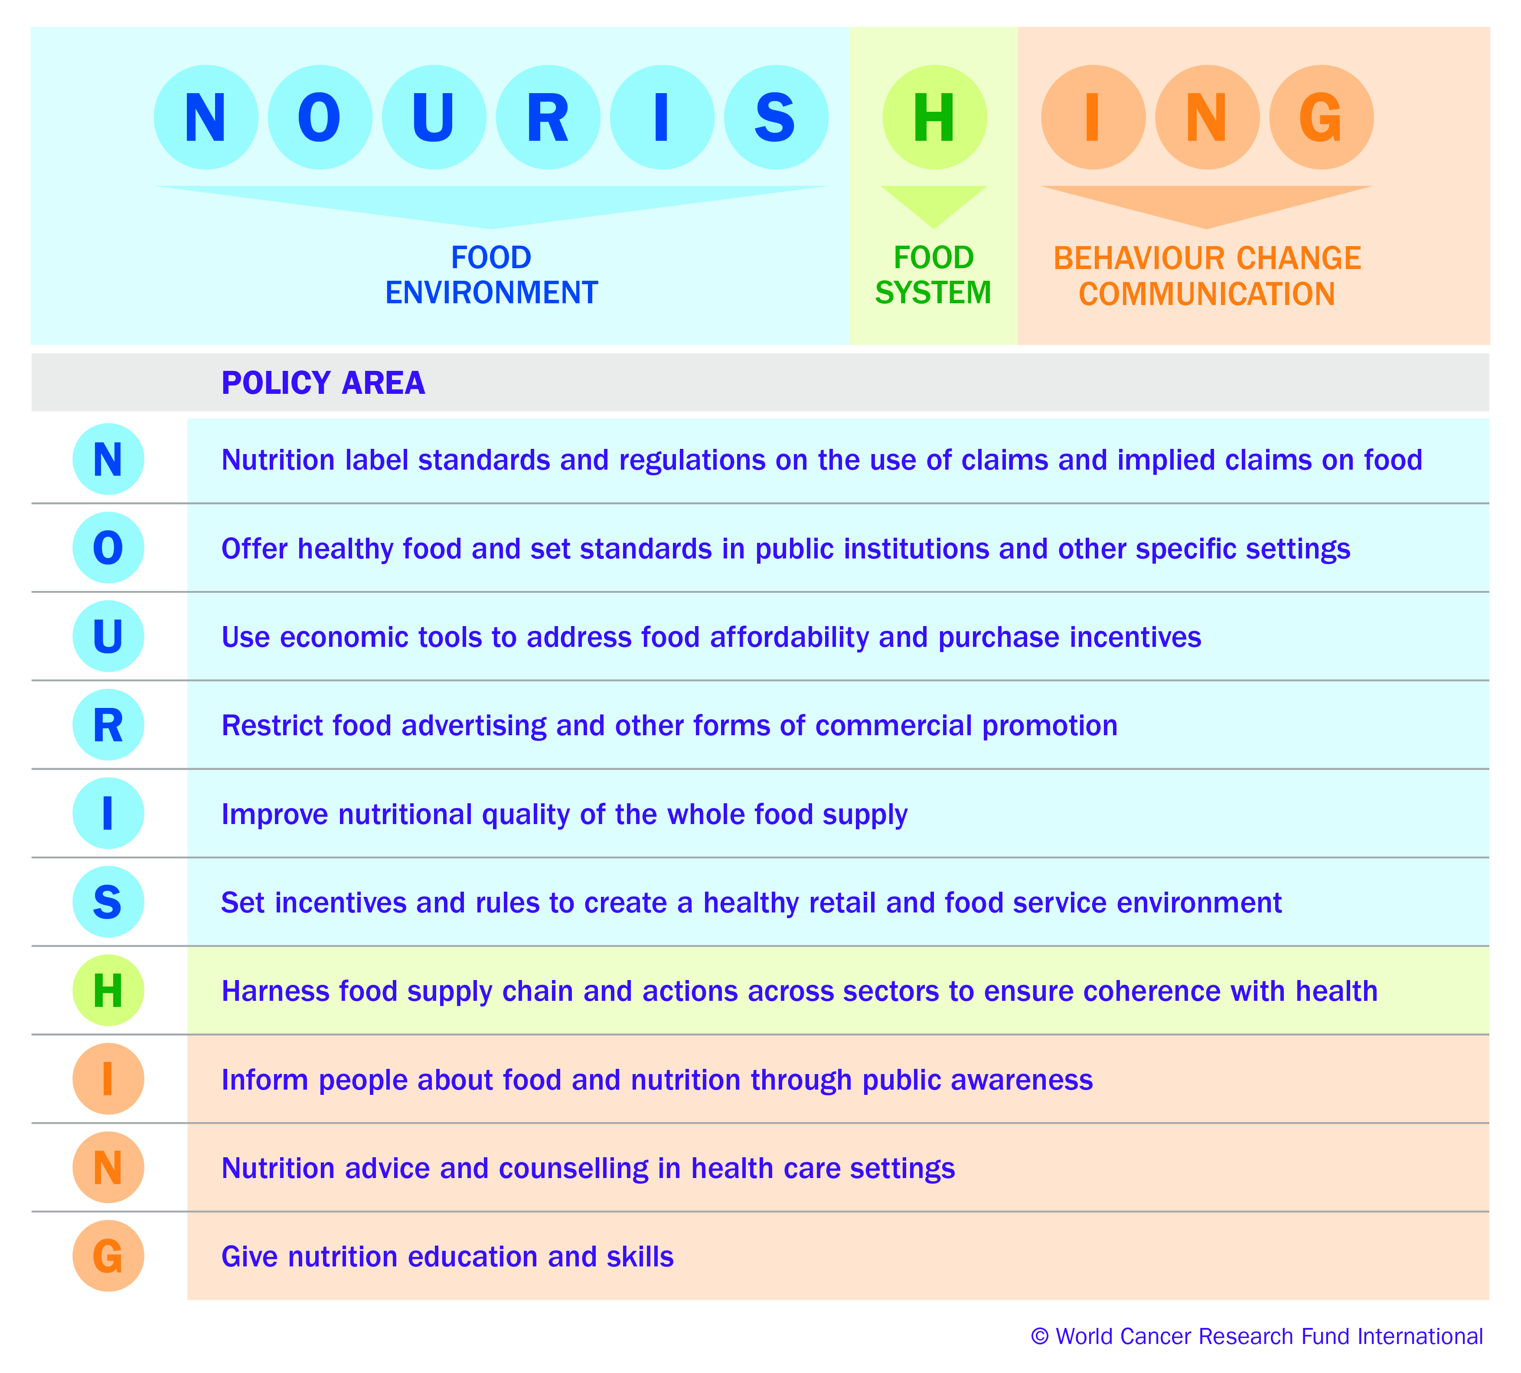
Our NOURISHING framework
www.wcrf.org/NOURISHING

Slide 36
New policy framework
Diet
Physical activity
Breastfeeding
Alcohol consumption
© World Cancer Research Fund International

Slide 37
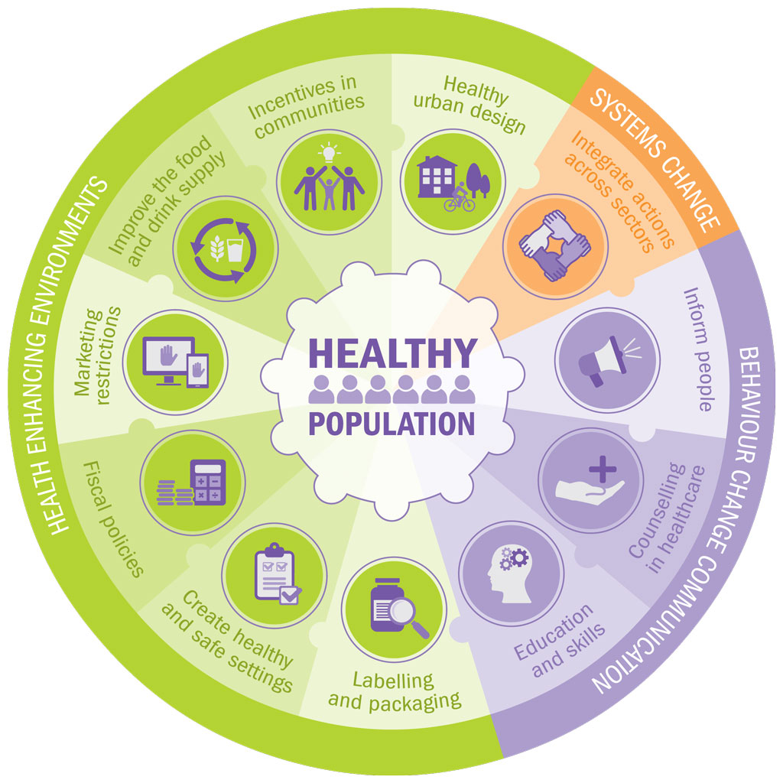
New policy framework
Policymakers
Civil society organisations
Researchers

Slide 38
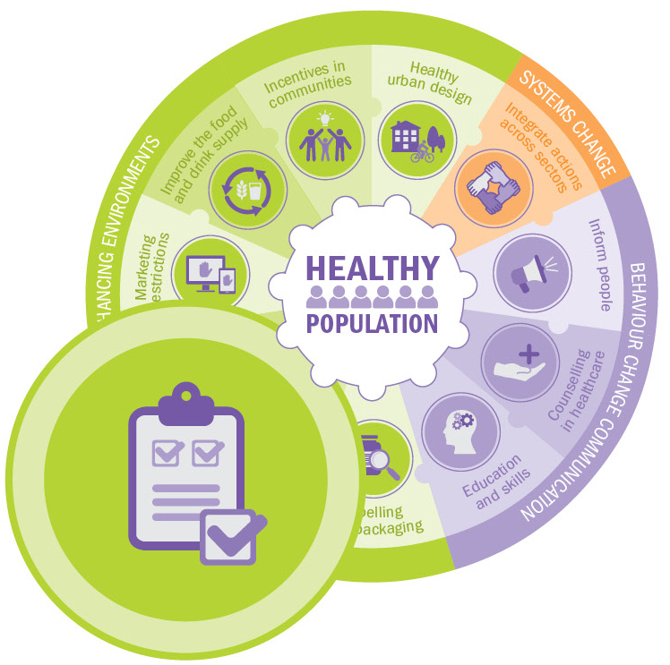
Create healthy and safe settings – example policy options
Diet: Nutrition standards in schools, workplaces, health facilities
Physical activity: Implement initiatives that optimize opportunities for physical activity (including walking and cycling to school)
Alcohol: Restrictions on alcohol consumption in educational buildings, workplaces and health facilities
Breastfeeding: Implement and/or expand the baby-friendly hospital initiative in health systems
© World Cancer Research Fund International

Slide 39
Fiscal policies – example policy options
Diet: Health-related taxes (e.g. sugar sweetened beverages
Physical activity: Incentives, tax deductions and targeted subsidies to support participation in physical activity
Alcohol: Excise taxes on alcoholic drinks
Breastfeeding: Maternity leave cash benefit
© World Cancer Research Fund International

Slide 40
Marketing restrictions – example policy options
Diet: Restrictions to all forms of food and drink marketing to children
Physical activity: Restrictions on sport partnerships and sponsorships with unhealthy products
Alcohol: Ban or implement restrictions on alcohol marketing and advertising across all types of media and sponsorship
Breastfeeding: Legislation to end inappropriate marketing of baby feeding products in line with the International Code of Marketing of Breast-milk Substitutes and subsequent resolutions
© World Cancer Research Fund International

Slide 41
Healthy urban design – example policy options
Diet: Planning restrictions on food outlets
Physical activity: Transport planning policies, systems and infrastructure that prioritise walking, cycling and use of public transport
Alcohol: Restrictions on density of on-premise and off-premise alcohol outlets and integration of public health considerations into relvant planning laws
Breastfeeding: Implement policies that encourage and support women to breastfeed in public
© World Cancer Research Fund International

Slide 42
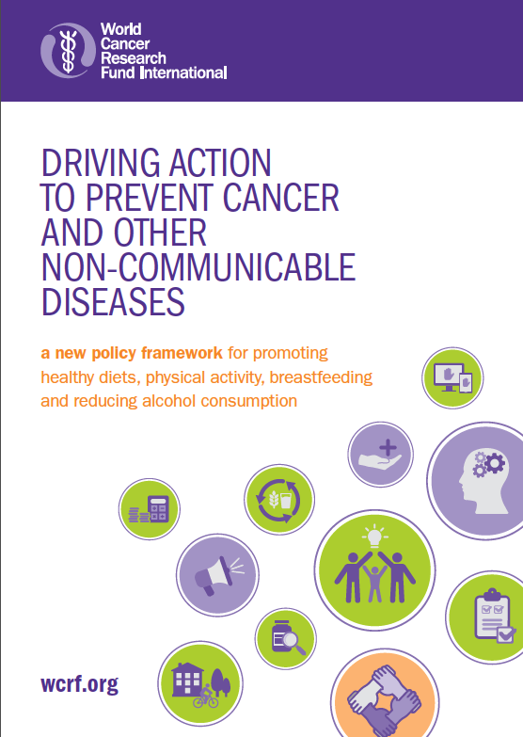
Driving Action – accompanying policy brief
www.wcrf.org/drivingaction

Slide 43
More action needed
“The sad part about NCDs is that it is only the focus and political will that we lack. Otherwise, many of the solutions are at hand…What is missing is implementation, implementation, implementation”
- WHO Director-General Dr Tedros Adhanom Ghebreyesus, January 2018

Slide 44
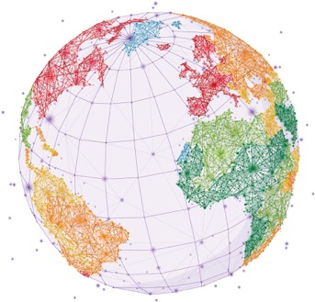
More action is urgently needed
Important policy actions are being taken around the world, but action to date has been insufficient
More concerted action is needed to achieve the global target of reducing premature deaths from NCDs, including cancer, by 25 per cent by 2025 and to achieve the related Sustainable Development Goals
Our evidence-based Cancer Prevention Recommendations can help inform policy action to benefit all
The new policy framework can be used by governments to identify policy actions to help create environments conducive to following the 2018 Cancer Prevention Recommendations

Slide 45
Thank you

